Slide 1
Project Review
Sketch To Code Node Web Application Using Azure Cognitive Services

Slide 2
Application Description
Web based application including Auth API
Transforming user made sketches to working code using Artificial Intelligence
Web interface and user accounts to store progress
Users may create projects, where individual components may be submitted and transformed to code
Utilising Azure Cognitive Services to create a model to determine and provide the best appropriate code snippet
Multi-Database storage solution

Slide 3
Research Findings
Discovered and examined the fundamentals and importance of wireframing in web design and application development
Wireframes are core elements to the creation and planning of an applications development
Prototyping using wireframes saves time and money
Provide a high quality deliverable in a short space of time
Clients observe wireframes to determine whether the proposed product meets their needs

Slide 4
Research Findings
Investigated the applications of computer vision and how such a process could be applied in practice
OCR (Optical Character Recognition)
HCR (Handwritten Character Recognition)
Discovered the importance of building a machine learning model
Object tagging
Nearest Neighbour Method

Slide 5
Research Findings
Understanding the fundamentals of cloud computing, while particularly focusing on Azure Cloud Services
Virtual Machines and Virtualisation
Discovered Hypervisors and investigated the basic function and use of such a technology (Type 1 – installed on server, Type 2 - contain a host operating system )
Azure Functions – how they interpret and handle loads and allocate resources appropriately only acting on an on-demand basis#
Storage blobs, their folder and data structures and accessibility

Slide 6
Existing Apps
Directly Applicable
Microsoft's Sketch2Code Using Cognitive Resources
Indirectly Applicable
Wirify – displaying websites as wireframes
In Vision - Freehand

Slide 7
Tech Stack
Backend
Node.js
Express.js
Frontend
Node.js
Material UI (MUI)
CSS
Microsoft Azure Cognitive Services
Custom Vision
Microsoft Database
Cosmos DB + Mongoose Schema
Storage Blob Account

Slide 8
What's Done So Far?
Initialised Azure Services (Storage Accounts, Prediction Model, access keys)
Login Authentication API (Cosmos DB)
CRUD (Projects + Components – Cosmos DB)
Generate Prediction from image provided to Custom Vision Model
Upload Files to Azure Storage blob from Frontend
Create Azure Storage Containers from Frontend

Slide 9
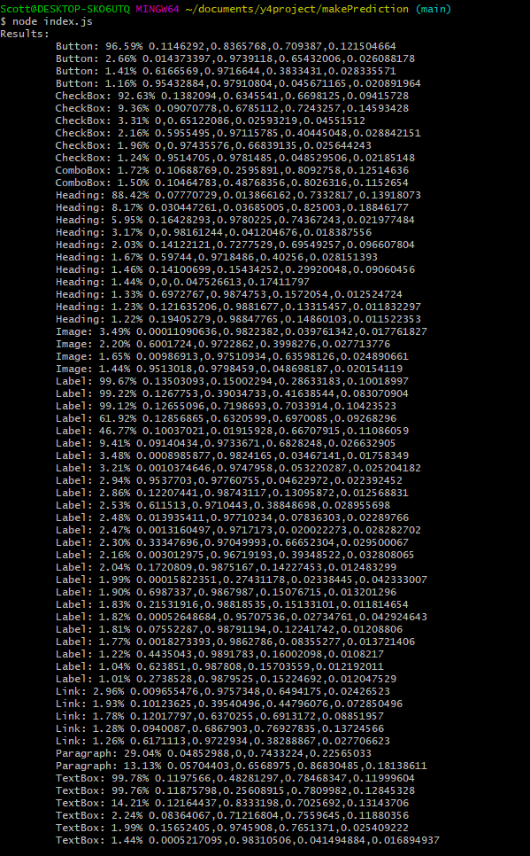
Demonstration
Prediction Model

Slide 10
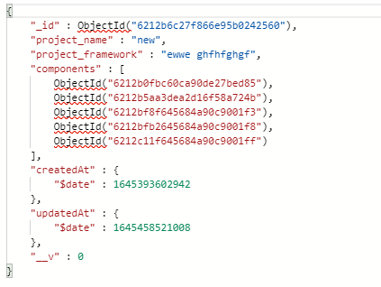
Cosmos API (Auth, Components, Projects)

Slide 11
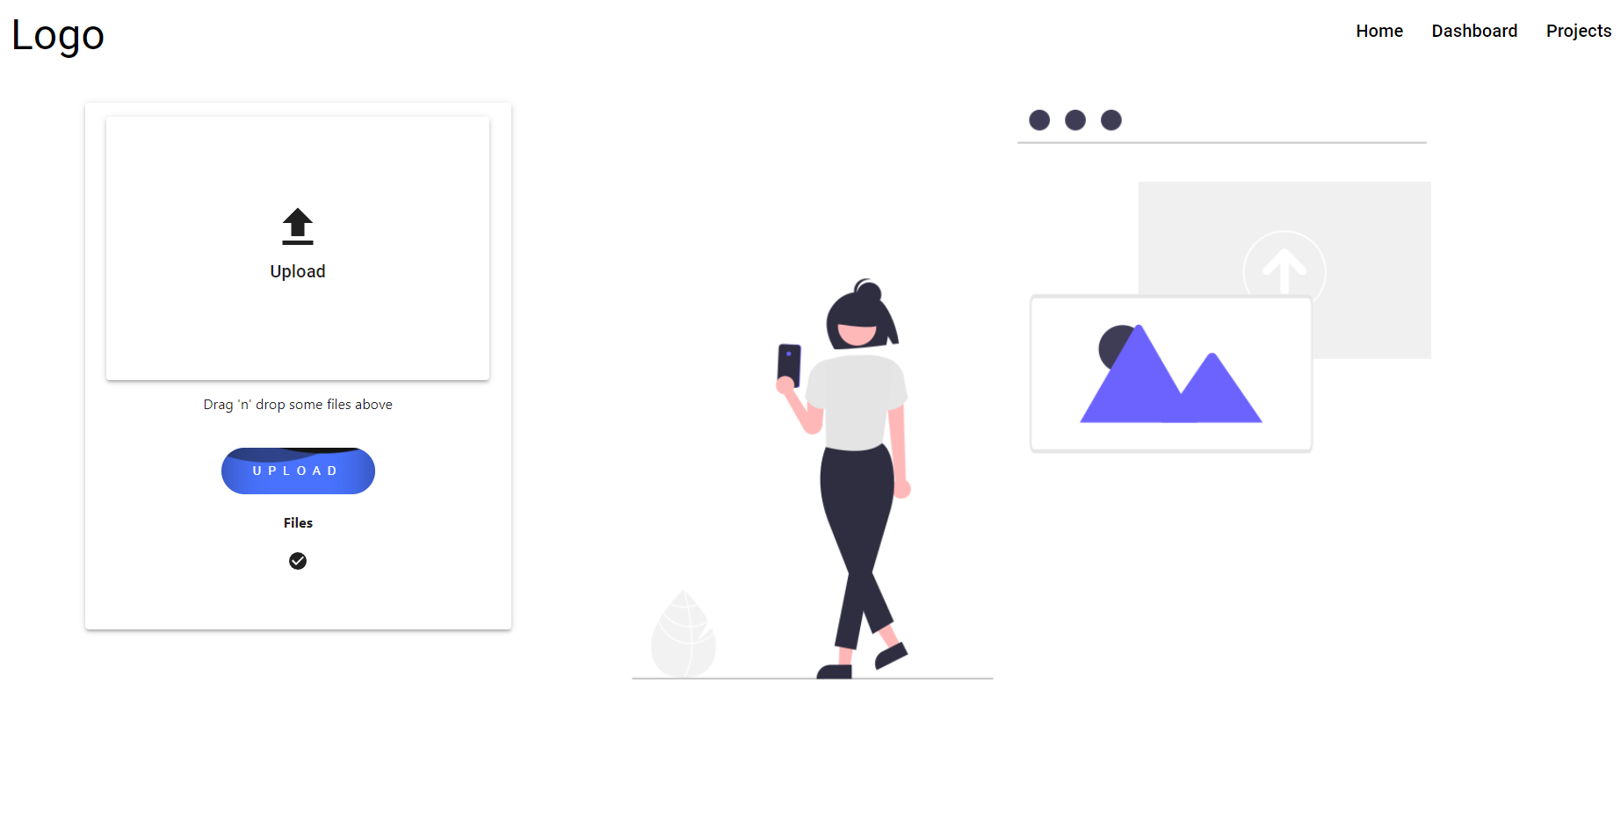
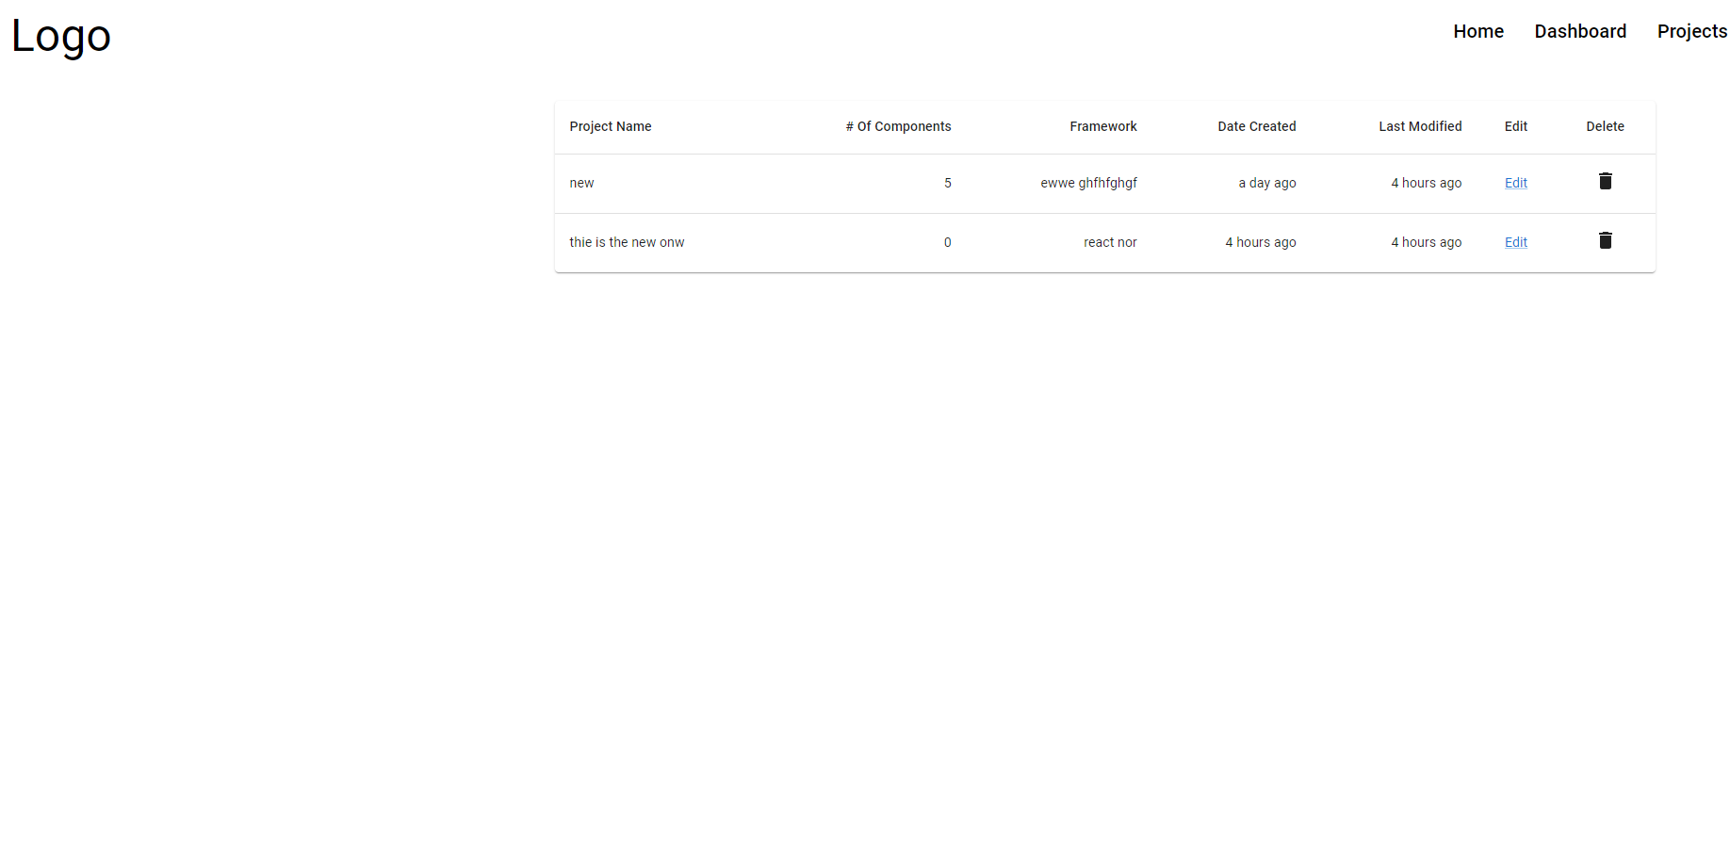
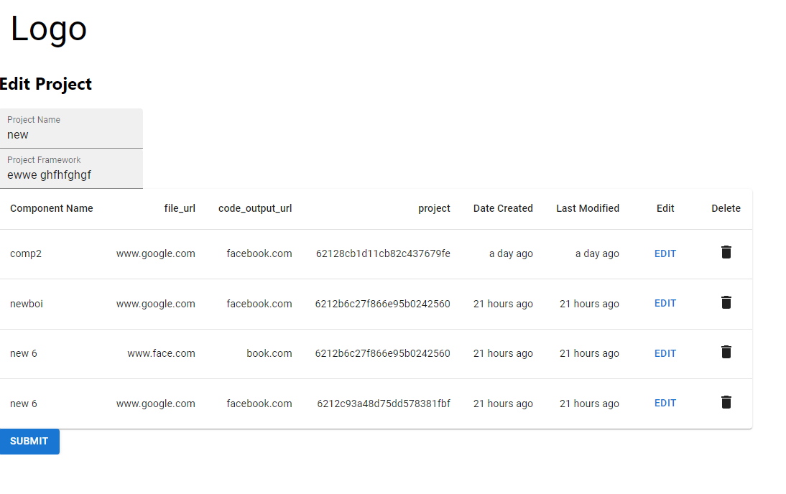
Frontend

Slide 12
What’s needs to be done
Create a new model using distinct colours
Link Cosmos DB components to storage blob objects
Feed Images from storage to prediction model
Allow users to upload an image and get a prediction
Create code snippets
Convert Sketch to code
Allow user to download code
Frontend Design
Documentation

